Slide 1
Hello Everyone, Assalamu Alaikum
I’m Md Liakot Ali Liton
Dept of Computer Science & Engineering(CSE)
ID: 1802035
Level: 1, Semister: II.

Slide 2
Project Name
Digital Attendance Taking System(DATS)

Slide 3
Project Objective
The main objective is to digitalized our attendance taking system.
Another important objective is to increase teachers research time by reducing extra time of attendance counting.
Further objective is to reduces the complexity of the teachers attendance sheet.

Slide 4
Inspirations Of The Project
Mainly inspired by our present attendance taking system.
Secondly inspired by digital world.

Slide 5
Project Advantages
This project can save our time,
It can calculate the total marks and attendance percentage correctly and fastly,
We can see our attendance every time,
It can save more than one class attendance file.
It can reduces the proxy tendency.

Slide 6
Functionalities
This project can store more than one class attendance record,
It can access any file at any moment and work on them,
It can delete or add any file every time,
It can show the student’s attendance table (with attendance percentage and marks) at any moment,
It can work in our previous created file.

Slide 7
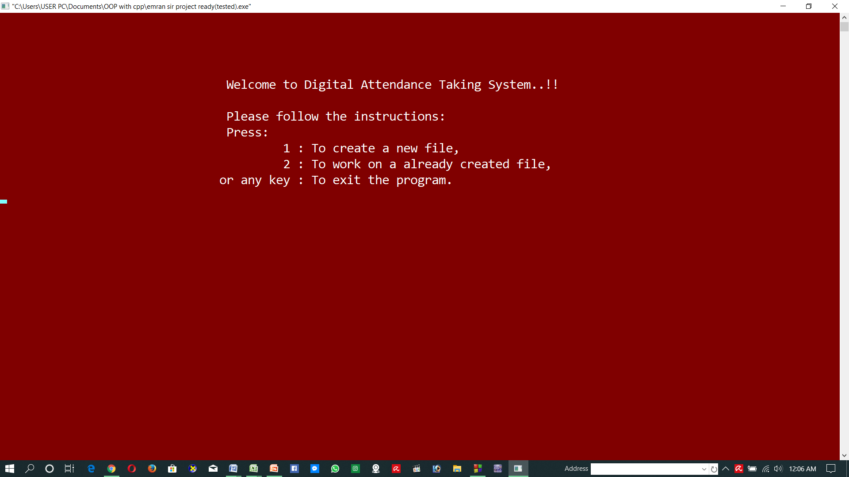
Project Output
Opening Window

Slide 8
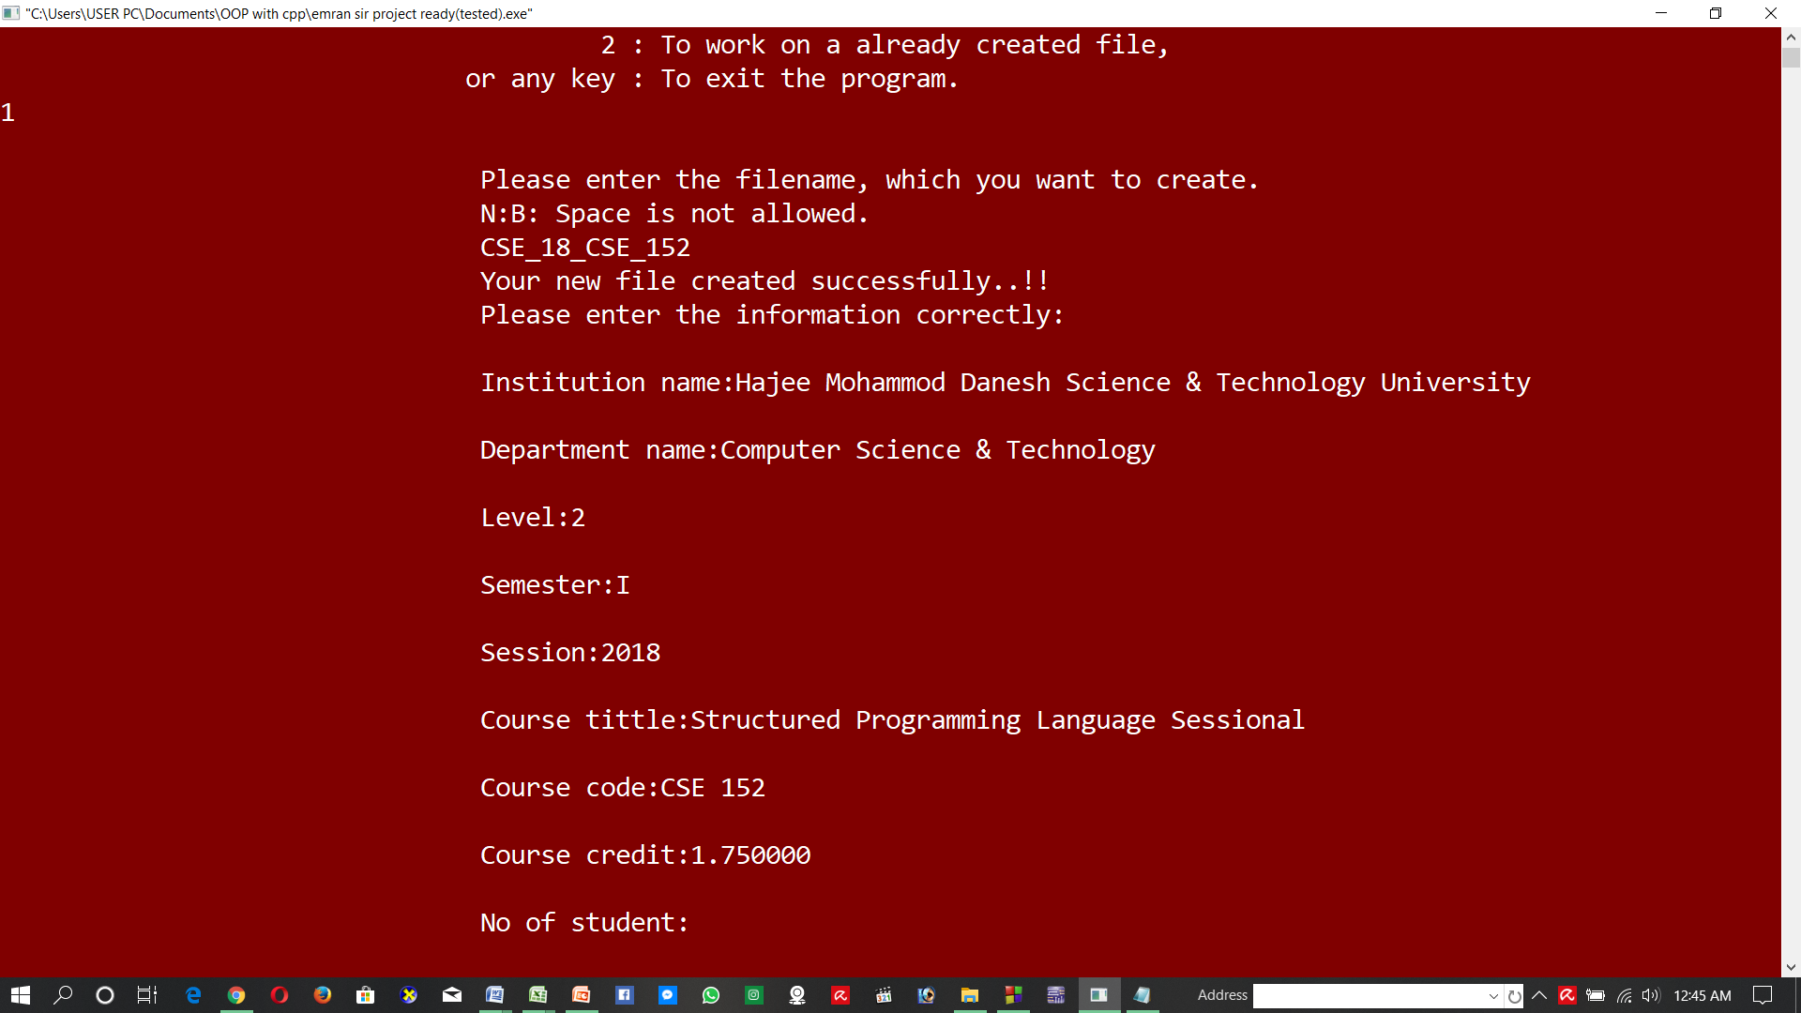
Project Output
New file created

Slide 9
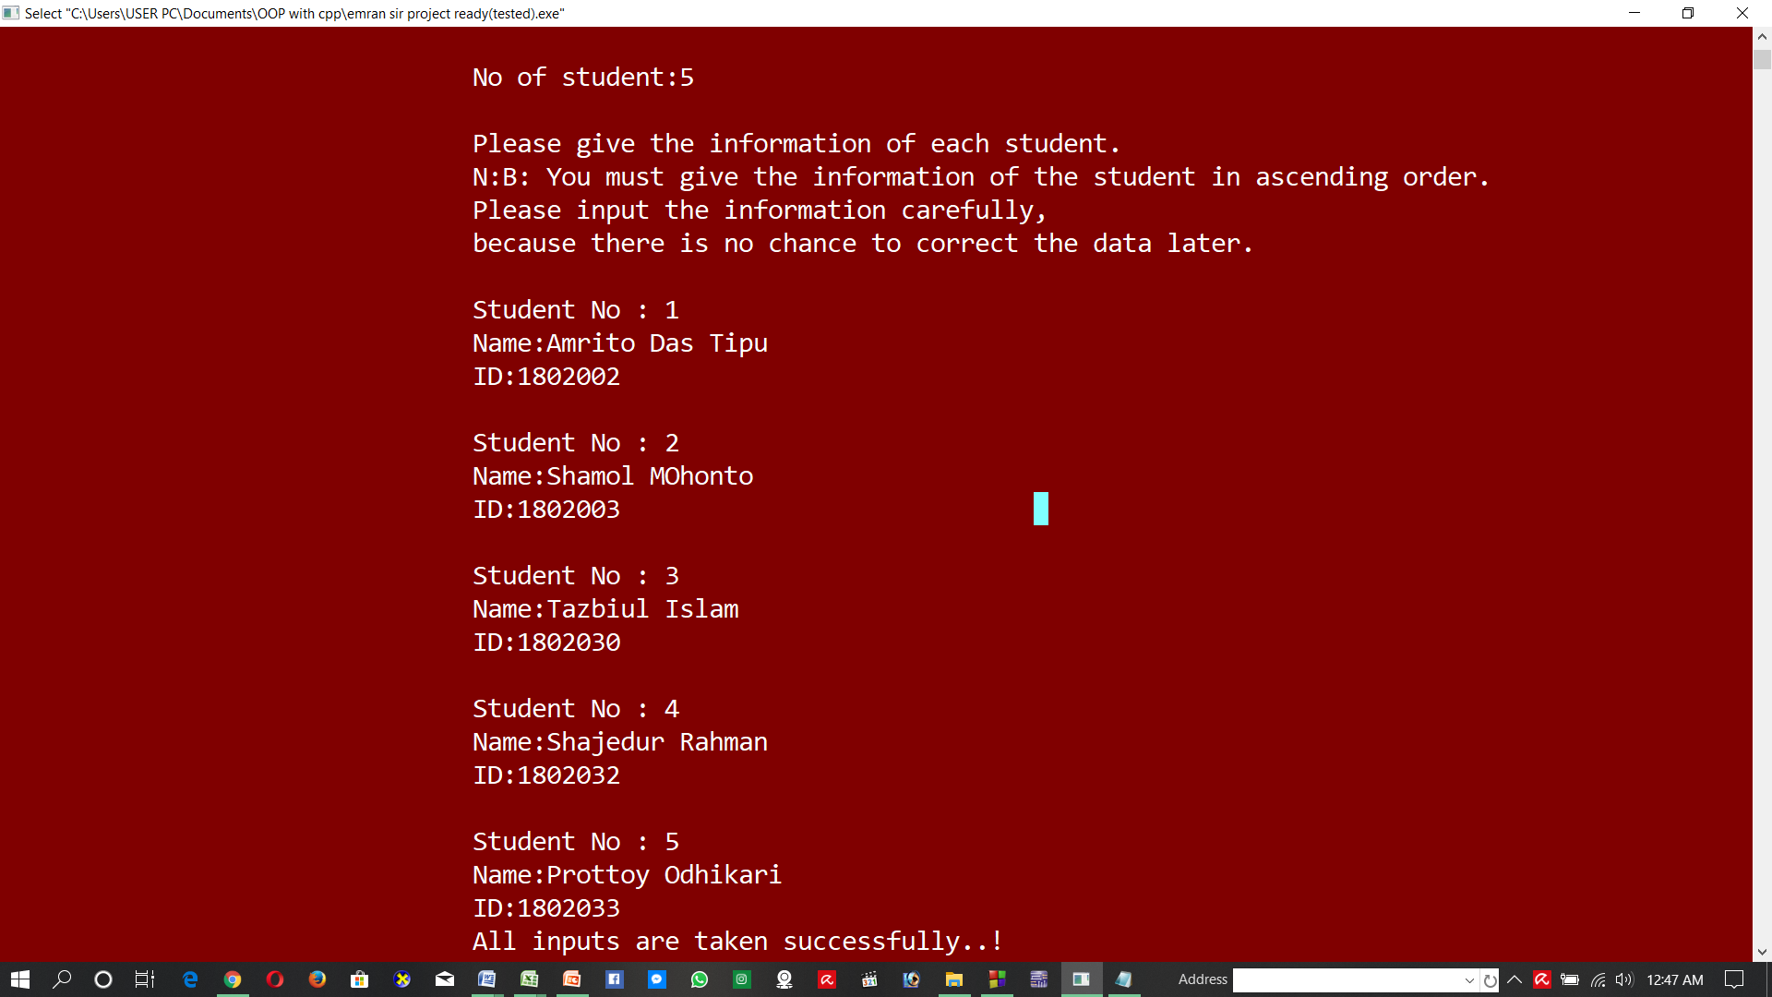
Project Output
Taking attendance

Slide 10
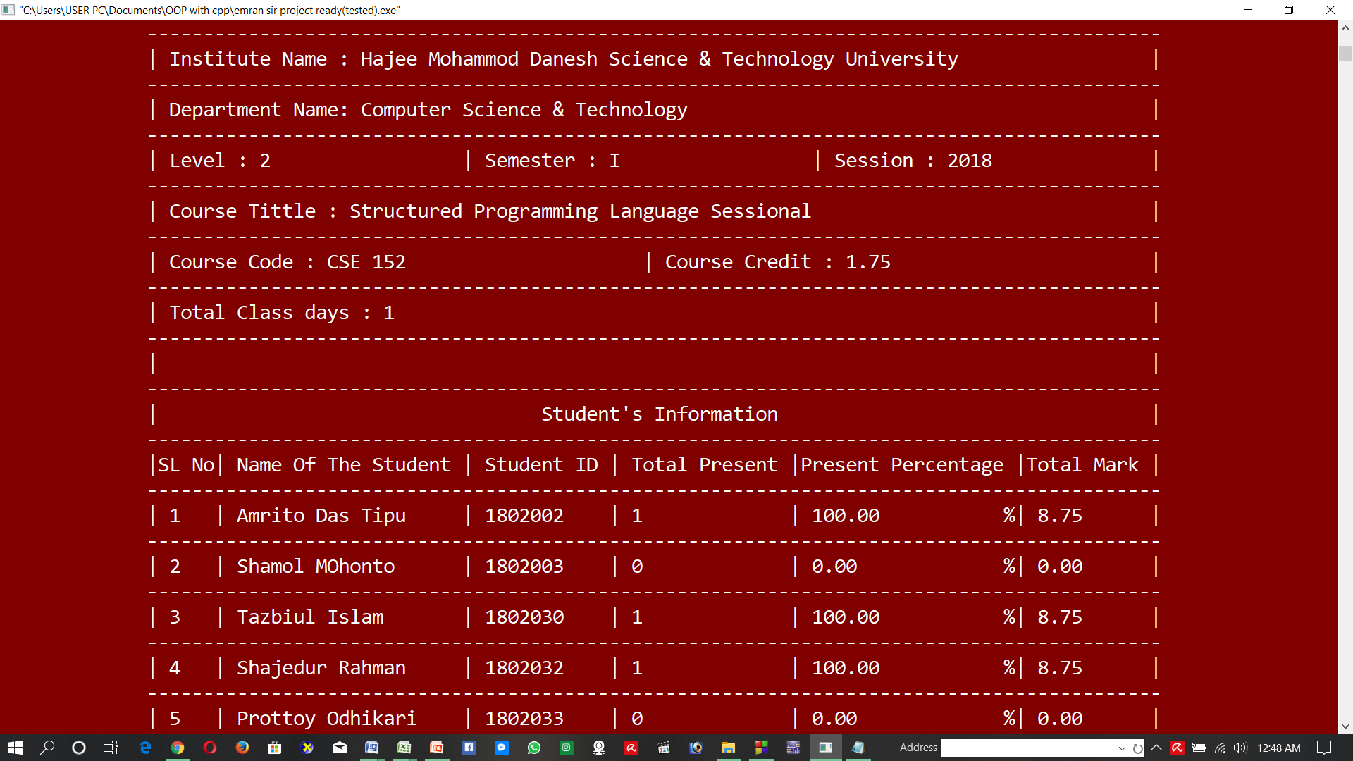
Project Output
Students table

Slide 11
Summary of the Project
At first using this project we have to create a file which contain department information and students information. Then the program show some option. Using the options you can take the attendance of the students, add new file or delete the file.
After taking attendance you can see the students attendance table which contain all the summary of the department. It also calculate the total attendance percentage and total mark per student depend on their present in the class and total class days.
This project can save our time in the class and reduces our complexity to count the students attendance mark.

Slide 12
Thanks Everyone..!!

